Slide 1
Manipulating the Table Structure
Create a Table
Create a Table with Constraints
Modify a Table’s Structure
Back Up Tables
Delete Tables

Slide 2
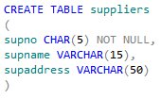
The CREATE TABLE Statement
The CREATE TABLE statement
Table name
Prevents storage of NULL values
Column names and definitions
Data type and size
Size enclosed in parentheses

Slide 3
Exact Numeric Data Types
Data Type | Range of Values Supported | Storage Size
bigint | -2^63 to 2^63 – 1 | 8 bytes
int | -2^31 to 2^31-1 | 4 bytes
smallint | -2^15 to 2^15-1 | 2 bytes
tinyint | 0 to 255 | 1 byte
bit | 1, 0, or NULL | Up to 8 bit columns, 1 byte; 9 - 16 bit columns, 2 bytes; and so on.
money | -922,337,203,685,477.5808 to 922,337,203,685,477.5807 | 8 bytes
smallmoney | - 214,748.3648 to 214,748.3647 | 4 bytes
decimal(precision, scale) | 1 to 9 digits of precision 10 to 19 digits of precision 20 to 28 digits of precision 29 to 38 digits of precision | 5 bytes 9 bytes 13 bytes 17 bytes

Slide 4
Approximate Numeric Data Types
Data Type | Range of Values Supported | Storage Size
float(n) | -1.79^308 to -2.23^308, 0, and 2.23^-308 to 1.79^308 | If n is 1 to 24, 4 bytes; if n is 25 to 53, 8 bytes.
real (equivalent to float(24)) | -3.40^38 to -1.18^-38, 0, and 1.18^-38 to 3.40^38 | 4 bytes

Slide 5
Date and Time Data Types
Data Type | Range of Values Supported | Storage Size
date | 0001-01-01 through 9999-12-31 | 3 bytes
datetime | January 1, 1753, through December 31, 9999 00:00:00 through 23:59:59.997 | 8 bytes
datetime2 | 0001-01-01 through 9999-12-31 00:00:00 through 23:59:59.9999999 | 6 bytes for precisions less than 3; 7 bytes for precisions 3 and 4. All other precisions require 8 bytes.
smalldatetime | 1900-01-01 through 2079-06-06 00:00:00 through 23:59:59 | 4 bytes
time | 00:00:00.0000000 through 23:59:59.9999999 | 5 bytes
datetimeoffset | 0001-01-01 through 9999-12-31 00:00:00 through 23:59:59.9999999 | 10 bytes

Slide 6
Character Data Types
Char
Varchar
Nchar
Nvarchar

Slide 7
Binary Data Types
Data Type | Storage Size
binary(n), where n is the number of bytes you want to reserve for the column. | 1 to 8,000 bytes
varbinary(n), where n is the maximum number of bytes the column can use. Varbinary is a variable-length data type, so it consumes storage space based on the values stored in the column. | Actual length of the data stored in the column plus 2 bytes.
image | 0 to 2^31-1 bytes

Slide 8
Other Data Types
Data Type | Purpose | Storage Size
timestamp (rowversion) | Use to assign a version identifier in binary to table rows. SQL Server changes this value for each INSERT or UPDATE statement you execute. | 8 bytes
xml | Use to store XML data. | Up to 2 GB
uniqueidentifier | Use to assign a unique ID to each row in a table. | 16 bytes

Slide 9
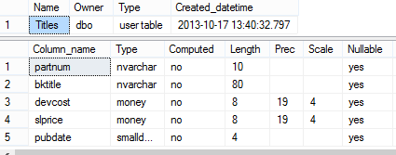
Table Design
Data types
Columns
Support for NULL values
Column width

Slide 10
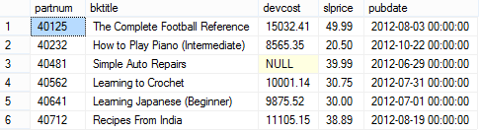
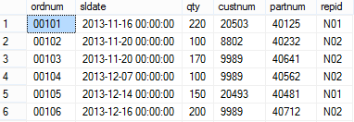
Data Integrity
All values are valid and can be used further
Linked columns have matching values
Constraint: qty<225
Each record is unique

Slide 11
Constraints
Column-level constraint
Domain integrity implemented
Defines rule to test column value
Constraint: qty<225

Slide 12
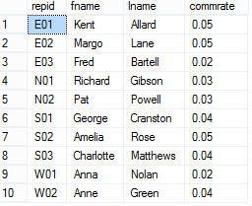
Primary Keys
Primary key
Uniquely identifies each row
Cannot store null or duplicate values

Slide 13
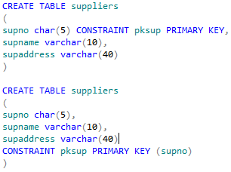
PRIMARY KEY Constraints
Constraint name
Creates column-level primary key constraint on supno column
Enforces uniqueness in the column for all rows
Creates table-level primary key constraint on supno column
Column chosen as the primary key

Slide 14
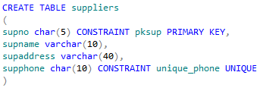
UNIQUE Constraints
Can accept null values
Column-level UNIQUE constraint
Enforces uniqueness in values stored in this column

Slide 15
Foreign Keys
Foreign key
Can contain duplicate values
Links records and stores matching values
Referenced table
Primary key

Slide 16
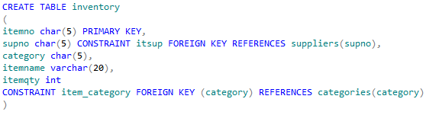
FOREIGN KEY Constraints
Referenced table and column names
Column-level foreign key constraint
Table-level foreign key constraint
Foreign key name
Cannot be modified; must delete and re-create

Slide 17
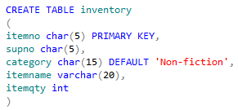
DEFAULT Constraints
Defined when creating a table
Created as a column-level constraint
Defines a default value for the column
Default value must match the data type of the column

Slide 18
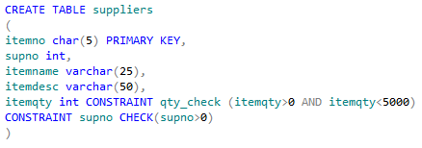
CHECK Constraints
Multiple linked expressions
Column-level CHECK constraint
Logical expression
Validates column value
Table-level CHECK constraint

Slide 19

The ALTER TABLE Statement
Modifies table structure
Modifies column definition
Adds a column
Deletes a column
Adds a constraint
Drops a constraint

Slide 20

The SELECT INTO Statement
The SELECT INTO statement
New table
Creates a backup of the table’s structure and data

Slide 21
The DROP TABLE Statement
Table to drop
Column definitions and constraints also dropped
Must drop any tables that reference this table first

Slide 22
Reflective Questions
How should you map business requirements and table designs before creating tables?
What basic constraints should you implement when creating a table?

